Slide 1


Cyber Security Language Models
Adapting Cyber Defense to the Advance of AI
© 2025 Athena Software Group Inc. Confidential & Proprietary. Do not distribute without express permission.
By Peter J Worth Jr
President & CEO, Athena Software Group

Slide 2

01
Mission Statement
02
Market Opportunity
ASG Overview
03
Who we are and what we do
04
Products & Services
05
Leadership Team
06
Financial Model

Slide 3
Athena Software Group Inc.
A company founded under the principles of integrating Cyber Security best practices, high end custom enterprise software and artificial intelligence (LLMs).
Athena Software Group brings together some of the best minds in computer science, cyber defense and SaaS to design solutions specifically for application service providers.
We take a fully integrated and analytical approach to Cyber Security defense, knowing through experience that the best Cyber Defense strategies arise from providing the best analysts with the best tools from within a fully integrated cyber security infrastructure that is informed by the latest cyber and t
We intend to set a new bar in Cyber defense by providing tools along the entire Cyber defense stack which are fully integrated with Cyber specific trained LLMs that both understand the global threat landscape AND are informed by the technical specifications which underpin the application specific infrastructure environment facilitating higher quality, more rapid and informed outcomes with respect to threat and anomaly detection, response management, vulnerability management and compliance.

Slide 4
Foundational Use Cases for Cyber Security Language Models
1. Threat Detection and Anomaly Identification
LLMs can analyze extensive logs, network events, and telemetry data, recognizing subtle patterns indicative of cyber threats or anomalies. They provide contextual understanding of suspicious activity, correlating seemingly unrelated events to identify potential breaches or attacks.
2. Security Incident Response Automation
Automating responses to standard security incidents by interpreting alerts, analyzing context, and suggesting or executing initial remediation steps. Streamlining the triage process to quickly prioritize critical threats based on context derived from past incidents.
3. Vulnerability Assessment and Management
Parsing security bulletins, advisories, and CVE databases to summarize and highlight critical vulnerabilities relevant to an organization's infrastructure. Generating actionable mitigation strategies and prioritization recommendations tailored to the organization's specific technologies and risk profile.
4. Phishing and Social Engineering Detection
Identifying suspicious patterns in emails, text messages, and other communication platforms by leveraging natural language understanding to detect phishing, impersonation, or manipulative techniques. Educating users by generating realistic phishing simulations or context-aware cybersecurity training content.
5. Cybersecurity Documentation and Compliance Automation
Generating compliance reports, incident documentation, and audit logs automatically, reducing the manual burden associated with regulatory requirements (e.g., GDPR, NYSDFS 23 NYCRR 500).Assisting in the interpretation of regulatory texts, summarizing complex cybersecurity requirements, and suggesting compliance actions.
6. Intelligent Threat Intelligence
Parsing vast amounts of threat intelligence data to provide concise, actionable insights tailored to an organization's unique threat landscape. Automatically generating intelligence reports or briefings about emerging threats and their implications for the organization.
7. Cybersecurity Assistant (Chatbot/Virtual Analyst)
Serving as a first-line assistant that provides cybersecurity support, answering questions about policies, procedures, recent threats, or incident response guidelines. Assisting cybersecurity analysts by summarizing logs, incidents, or threat intelligence data to expedite informed decision-making.
8. Code and Software Security Analysis
Reviewing code repositories, documentation, and logs to identify potential security weaknesses, such as insecure coding patterns, hardcoded credentials, or risky configuration settings. Suggesting secure coding practices and generating contextual remediation steps.
9. Enhanced SIEM and Log Analysis
Integrating LLMs with Security Information and Event Management (SIEM) platforms to provide enhanced semantic understanding of security logs, correlate events, and reduce false positives through natural language analysis. Improving root-cause analysis by interpreting event logs and contextualizing security events.
10. Retrieval-Augmented Generation (RAG) for Security
Employing RAG models to access up-to-date cybersecurity knowledge bases or internal documentation, providing timely, accurate, and contextually relevant answers during security incidents or routine operations.
Threat intelligence application is the target for first phase, with incident response, compliance automation, analysts support and RAG integration (1, 2, 5, 7 and 10) as potential targets thereafter. Models must be trained on Cyber security data (public + private) and then plugged into the environment for proper contextualization and customization of output

Slide 5
Cyber Security Language Models
Model Name | Introduced | Developer(s) | Base Model | Training Methodology | Targeted Domains
CyberPal.AI | Aug-24 | Matan Levi et al. | Not specified | Instruction tuning with SecKnowledge dataset; evaluated using SecKnowledge-Eval benchmark | Threat hunting, malware analysis, vulnerability assessment, incident response
Llama-Primus | Feb-25 | Trend Micro AI Lab | Llama-3.1-8B-Instruct | Continual pretraining on cybersecurity corpus; instruction fine-tuning with curated QA tasks | Cyber threat intelligence, vulnerability classification, security certification preparation
SecBERT | 2022 | jackaduma | BERT | Pretrained from scratch on cybersecurity texts including APTnotes, Stucco-Data, CASIE, and SemEval-2018 Task 8; custom vocabulary | Threat intelligence, NER, text classification, semantic understanding, Q&A in cybersecurity context
SecureBERT | 2022 | Ehsan Aghaei et al. (UNC Charlotte) | BERT | Continual pretraining with customized tokenizer on large corpus of cybersecurity text | Cyber threat intelligence, cyber automation, phishing detection, code and malware analysis, intrusion detection
CTI-BERT | Dec-23 | IBM T.J. Watson Research Center | BERT | Pretrained from scratch on high-quality cybersecurity corpus containing CTI reports and publications | Cyber threat intelligence extraction, security entity (IoCs) extraction, attack technique (TTPs) classification
SecurityLLM | Jan-25 | ZySec-AI | Zephyr-7b-beta | Direct Preference Optimization (DPO) training across 30+ security domains | Threat analysis, compliance verification, security architecture reviews, SOC operations, risk management
SecurityBERT | Jun-23 | Mohamed Amine Ferrag et al. | BERT | Privacy-preserving encoding technique (PPFLE) combined with Byte-level Byte-Pair Encoder (BBPE) Tokenizer; trained on IoT data | Cyber threat detection in IoT/IIoT devices
Variety of models have been introduced with a broad range of test methodologies and applications. Technology development and adoption is still in its infancy.

Slide 6
Different Training Strategies
Aspect | Traditional Fine-Tuning | Instruction Tuning | Hybrid Approach
Description | Adapting a general-purpose model to cybersecurity by updating weights on a large unlabeled/labeled domain corpus | Adapting a model to follow explicit instructions in natural language format across various cybersecurity tasks | Combines traditional fine-tuning on a domain corpus followed by instruction tuning or integrates both into a single multi-objective training setup
Input Format | Raw cybersecurity texts (blogs, CVEs, advisories) | Tuples like (“Map this CVE to MITRE ATT&CK”, CVE text → expected answer) | First: domain texts → corpus adaptation; then: curated instructions → multi-task generalization
Training Objective | Masked Language Modeling (MLM) or Causal Language Modeling (CLM); optionally with classification/regression heads | Supervised generation / classification using cross-entropy loss | Pretrain or adapt with MLM, then instruction tune; or mix the objectives (e.g., multi-task loss)
Best For | Embedding learning, classification, entity recognition, internalizing domain-specific syntax and jargon | Multi-turn reasoning, question-answering, structured task execution (e.g., IOC extraction, root cause summarization) | Use cases needing both strong domain understanding and complex task following (e.g., SOC assistant, security triage)
Sample Cyber LLMs | • CTI-BERT (IBM) • SecureBERT (UNC) • SecBERT (jackaduma) • SecurityBERT (IoT) | • CyberPal.AI • Llama-Primus • SecurityLLM • Sec-Gemini v1 (RAG + instruction) | • Llama-Primus (base → merged) • CTI-BERT + instruction adapters • CyberPal.AI w/ SecKnowledge → SecKnowledge-Eval loop
Strengths | ✔ Captures nuanced cybersecurity terminology ✔ Improves base model for domain-specific NLP tasks | ✔ Generalizes across task types ✔ Interpretable and human-aligned ✔ Easier downstream zero-shot/few-shot use | ✔ High performance in both static understanding and reasoning ✔ Flexibility across tasks ✔ Lower label dependency if pretrained well
Weaknesses | ✖ May not generalize well to unfamiliar task formats ✖ Doesn’t teach “task framing” | ✖ Requires high-quality curated instruction data ✖ May hallucinate if not grounded | ✖ Expensive and complex training pipeline ✖ Risk of forgetting if improperly scheduled
Compute Requirements | • Requires moderate GPU resources for continual pretraining (e.g., 8x A100 for 100M tokens) • Good fit for distributed training | • Typically less data but more curated, though larger sequence lengths and decoder-based models (e.g., LLaMA, GPT) may demand more memory • 8x A100 for ~20K examples | • Highest resource requirement: pretraining on corpus (TPU/8x A100) + instruction finetuning (decoder model, RAG-enabled, ~24GB GPU RAM or more)
Parameter Efficient Tuning | Supported via LoRA, Adapters (sparse updates) | Works well with PEFT (e.g., QLoRA, LoRA), especially for instruction-tuning-friendly architectures | Common hybrid practice: LoRA for instruction head + frozen backbone or adapter fusion
Instruction-Awareness | ❌ Model is unaware of instructions explicitly | ✅ Instruction-following enabled | ✅ Instruction-aware + domain-knowledge enriched
Fine-Tuning Duration | Long (10–40 hours for 100M tokens depending on model size) | Medium (4–12 hours for 20K–100K examples depending on format) | Longest (20–80 hours if running pretrain + instruction + eval loop with RAG)

Slide 7


Adapting LLMs for Cyber Security
Hybrid approaches are proving to be the most effective and involve a combination of traditional finetuning strategies along with the instruction based tuning and RLHF. Source: https://gradientflow.com/maximizing-the-potential-of-large-language-models/

Slide 8
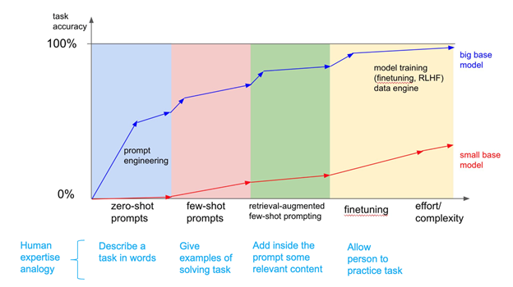
Evolution of Finetuning Approaches
https://www.signalfire.com/blog/comparing-llm-fine-tuning-methods

Slide 9
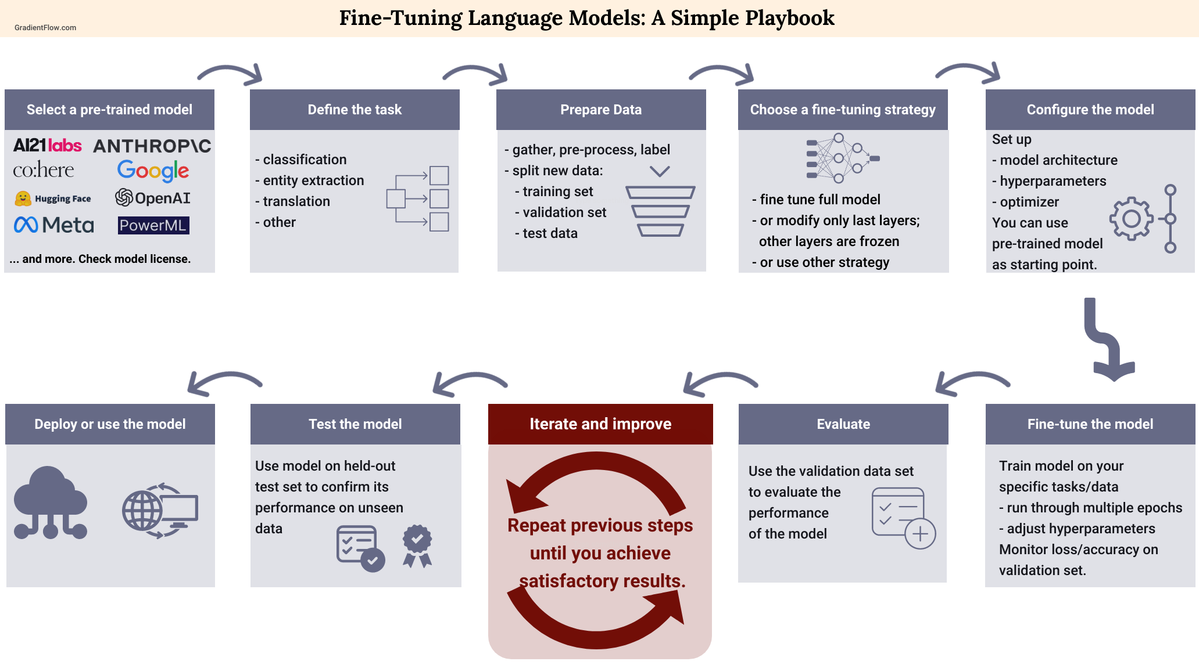
The LLM Dev-Test-Deploy Workflow
Importance of Proper Benchmarking (testing)
https://gradientflow.com/maximizing-the-potential-of-large-language-models/

Slide 10
Evaluating the Performance of Cyber Security LLMs
Benchmarks for Cyber Security Language Models
Benchmark | Organization / Authors | Open Source | Cybersecurity Domain | Key Tasks | Introduced In
CTIBench | University of Waterloo & AI4Sec | Yes (GitHub, Hugging Face) | Threat Intelligence, Vulnerability Analysis, Threat Attribution | CTI-MCQ, CTI-RCM, CTI-VSP, CTI-TAA | Jul-24
SecKnowledge-Eval | CyberPal.AI (Authors of SecKnowledge Paper) | No (Contact authors) | Instruction Following, Threat Analysis, Security Reasoning | Threat/attack pattern understanding, contextual security tasks | Aug-24
CyberSecEval 2 | Meta AI | No | Offensive & Defensive Cybersecurity, LLM Risk Assessment | Malicious instruction handling, threat detection, security training evaluation | Apr-24
Sophos Benchmark Suite | Sophos AI | No | SOC Operations, Incident Handling | Incident summarization, SQL generation, severity rating | Mar-24
SECURE | Rochester Institute of Technology | Partially (some datasets) | ICS Security, Threat Reasoning | Knowledge extraction, understanding, reasoning in ICS scenarios | May-24
Cybench | CTF Community Researchers | Limited (some CTF challenges) | Offensive Security, Exploit Development | CTF task solving, vulnerability discovery, exploit execution | Jun-24
Evaluation of open source benchmarks, applicability to threat intelligence specifically and potentially expanding and creating our own benchmark that speaks to the capabilities around Flashpoint Threat Intel specifically.

Slide 11
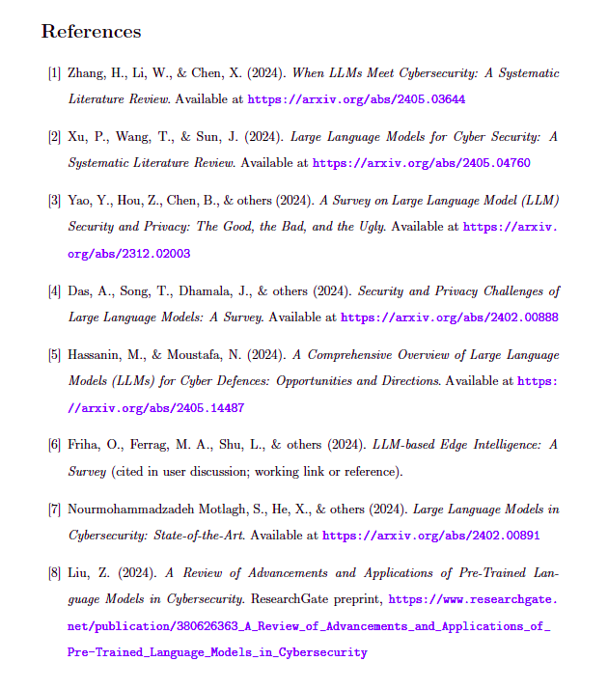
Survey Research Literature in Cyber Security

Slide 12

Athena Software Group
Best in Class, AI Enabled, security solutions for Enterprise application providers.

Slide 13


Glaukopis (γλαυκῶπις) the “grey eyed one”

